Slide 1




Audio
Denoising
1

Slide 2
Table of contents
01
02
03
04
05
Introduction
Problem Definition
Methodology
06
Implementation
Test & Result
Conclusion & future work
2

Slide 3
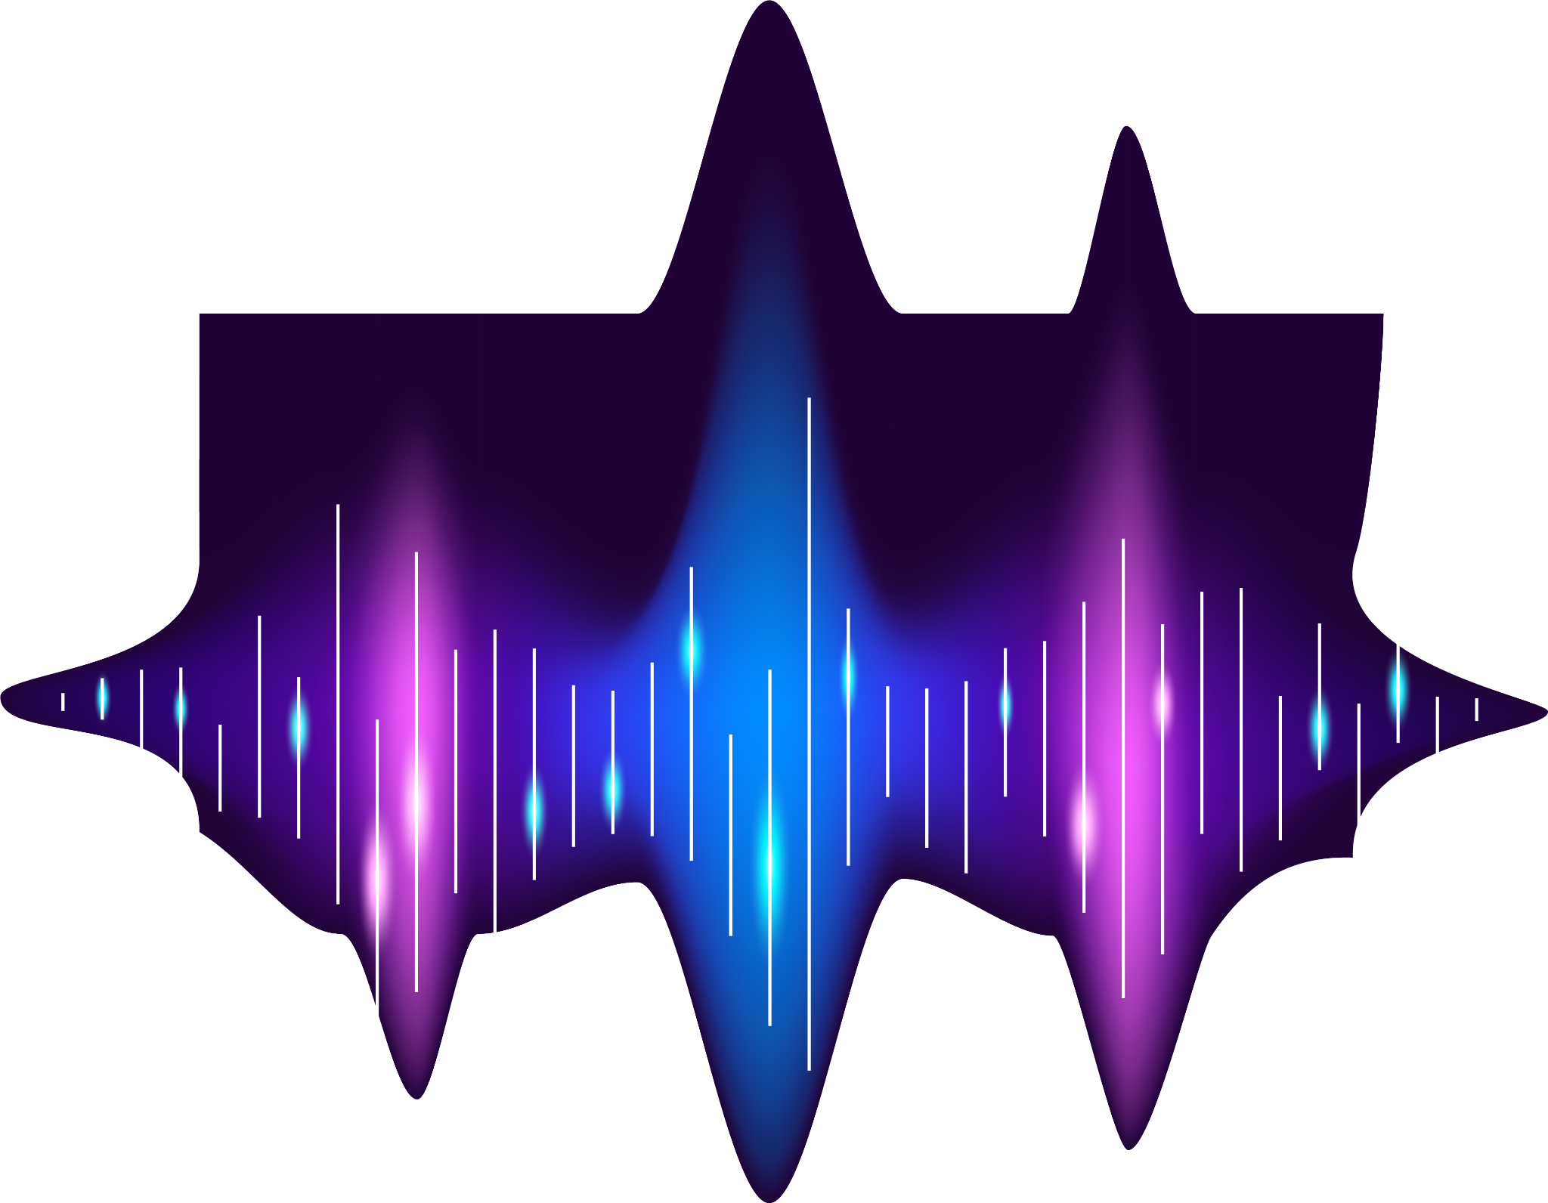
01
Introduction
3

Slide 4
Motivation
01
Improving the quality of audio
Improve Communication
enhancing clarity in recordings
4

Slide 5
02
Problem definition
6

Slide 6
History of denoising
Methods
02
02
Audio denoising dates back to early 20th century
FIR filter
IIR filter
WAVELET TRANSFORM
Deep learning
7

Slide 7
Methodology
03
8

Slide 8

Methodology
03
FIR & IIR Filters
PDE & CWT
Thresholding
9

Slide 9
Implementation
04
10

Slide 10
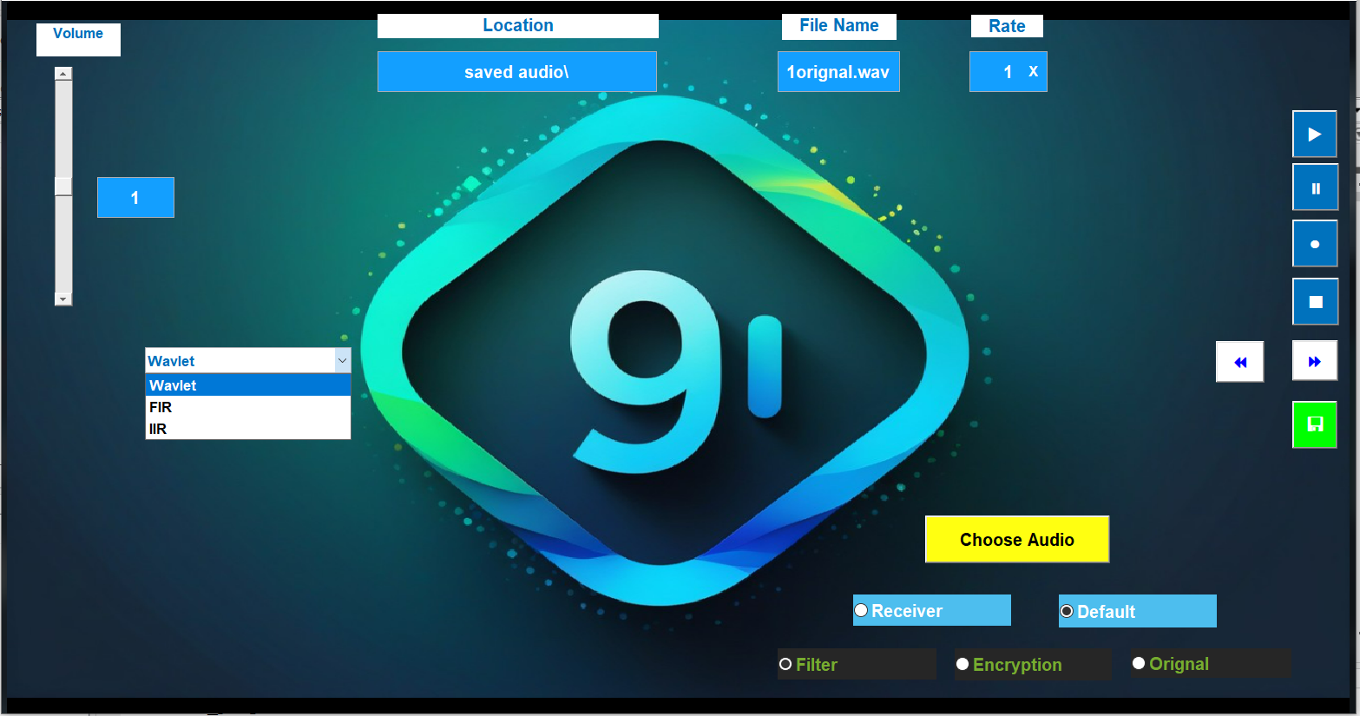
Software
04
Volume
Control
File details
Speed
Speed control
Choose
Save
Filters
Modes
11

Slide 11
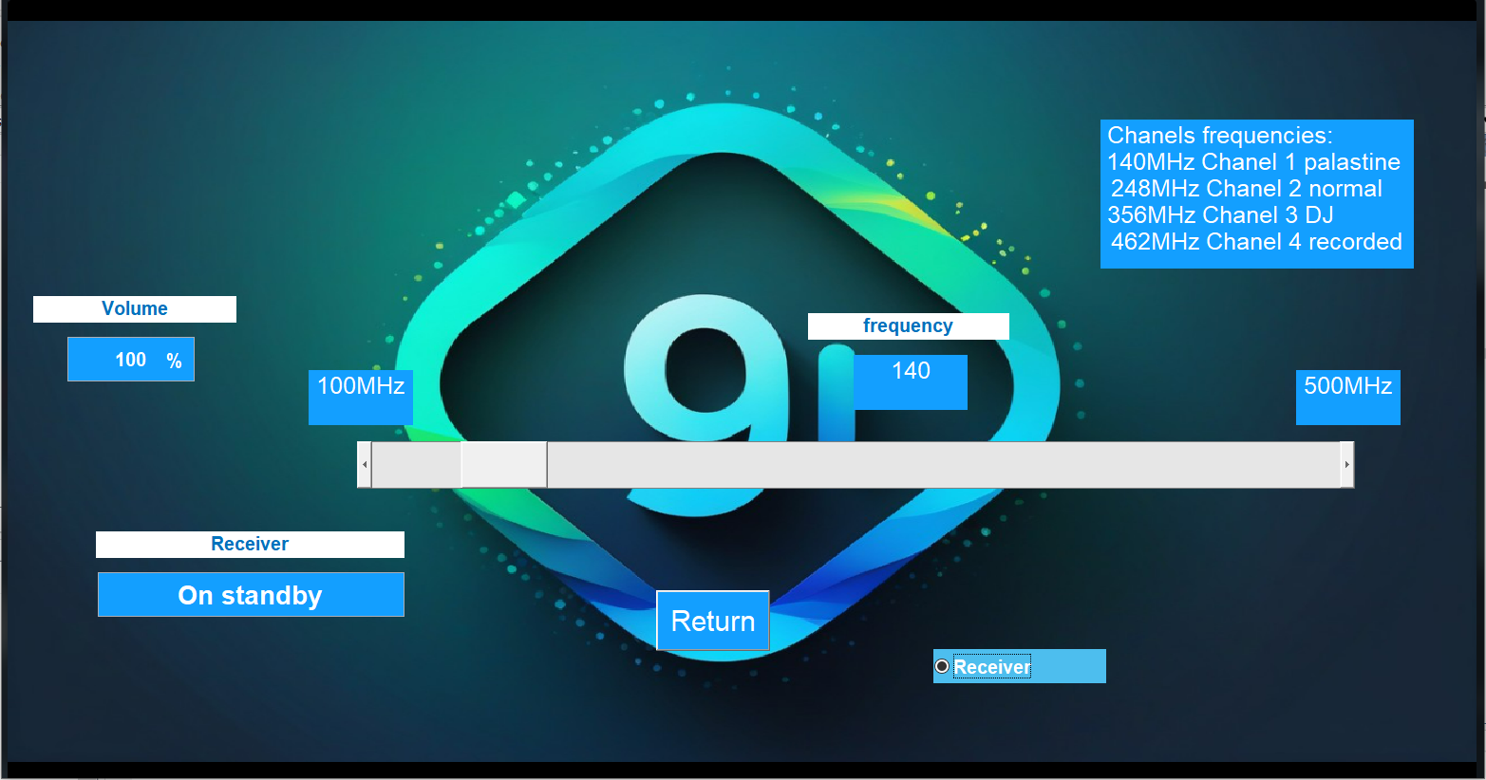
Software
04
Volume
Channels
Frequency
State
Radio Slider
Return
12

Slide 12
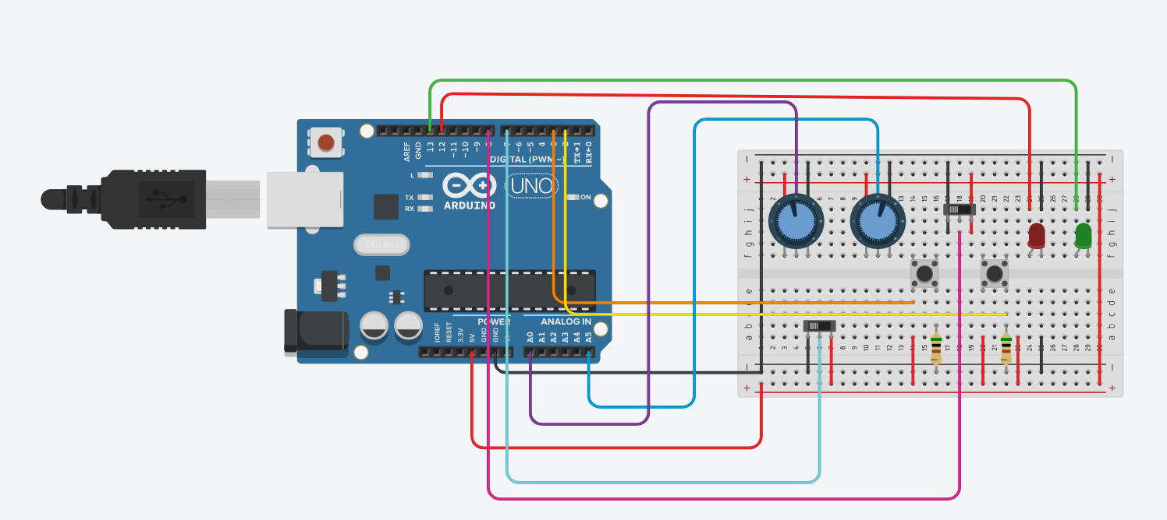
Hardware
04
USB Cable
Frequency
AM/FMswitch
Arduino UNO
Volume
LED
Button
On/Off switch
13

Slide 13
Price
04
Components: 10$
Programming: 240$
Total: 250$
13

Slide 14
System Description
04
User
Selections Button
Volume
Channel
State
LEDs
Arduino
Serial Port
Coded Message
Audio Processing Program
Sound File
15

Slide 15
Test & Result
05
16

Slide 16
Experiment Results
05
17

Slide 17
Experiment Results
05
18

Slide 18
06
Conclusion & future work
19

Slide 19
Conclusion
06
The Wavelet is the best method
No difference between FIR and IIR
Highest performance is achieved at normal frequency (40-60) kHz.
20

Slide 20
Future Work
06
test the Adaptive LMS algorithm
Impulse & Step Invariance
21

Slide 21
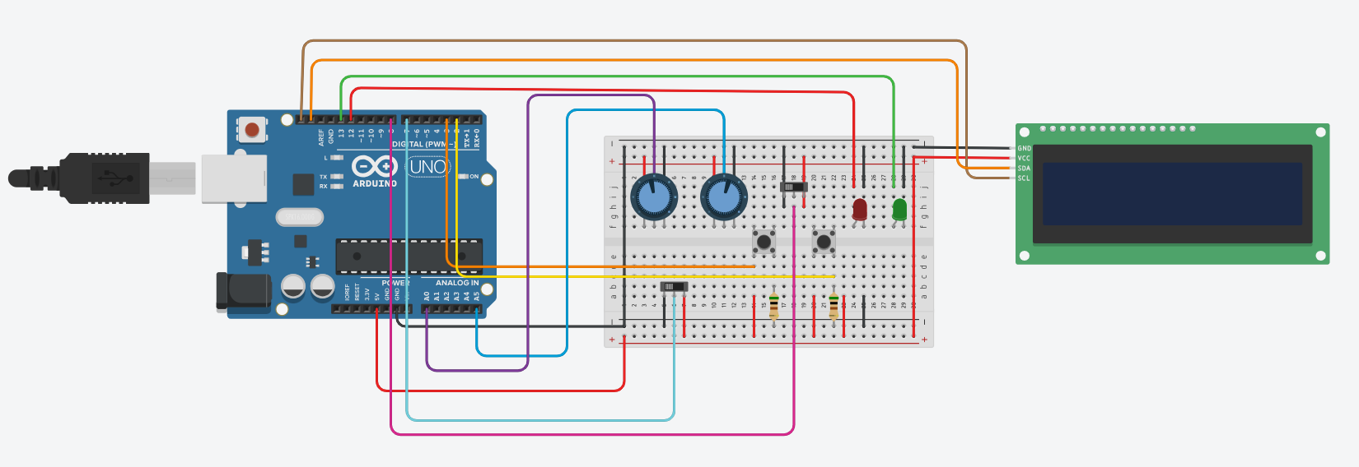
Hardware Future Work
06
Frequency
LCD
USB Cable
AM/FMswitch
Arduino UNO
Volume
LED
Button
On/Off switch
22

Slide 22
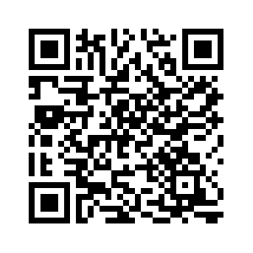
any questions?
Reference
23

Slide 23
Thanks!
24

